Slide 1
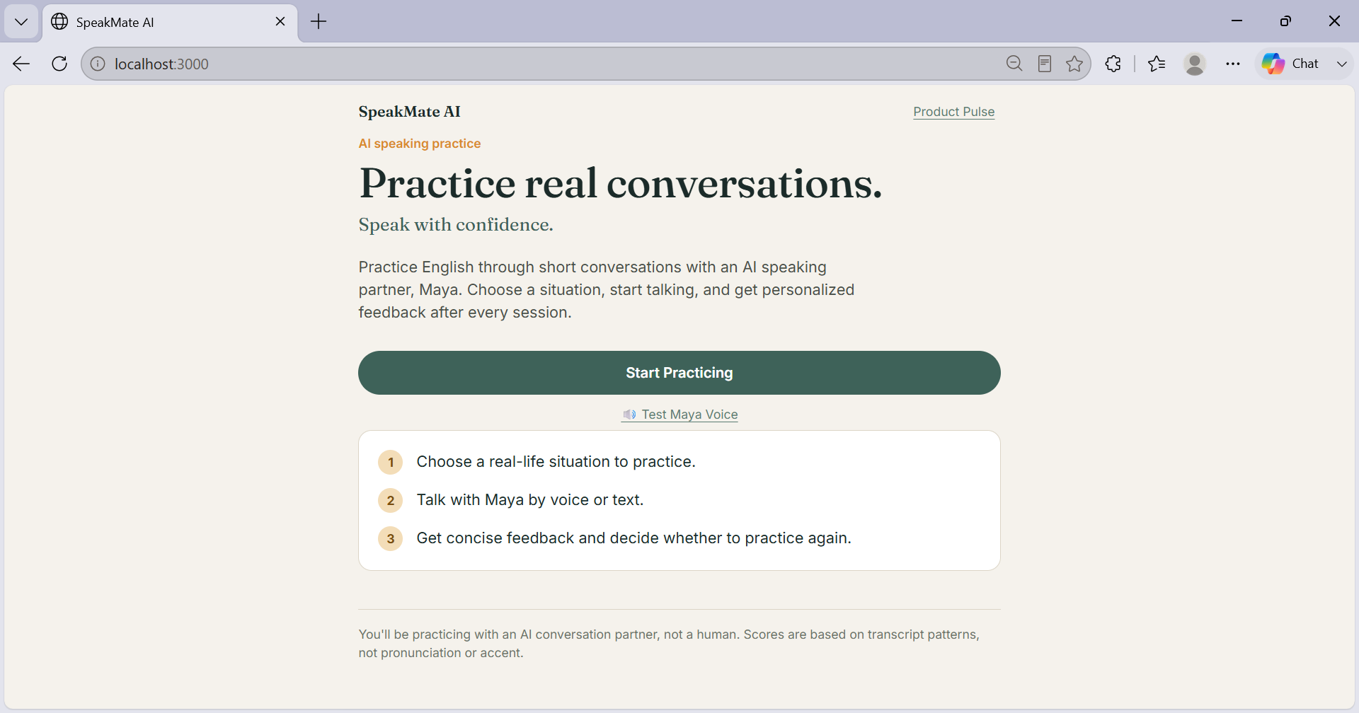
AI SPEAKING PRACTICE
SpeakMate AI
Practice real conversations.
Speak with confidence.
An AI speaking partner for students and early-career users.
Product Case Study — Product / AI Product Internship Assignment

Slide 2
The Problem
WHO
Students and early-career users preparing to speak English confidently.
HYPOTHESIS
“Speaking English is easier to understand than to practice.”
“If speaking practice feels like a short conversation with a supportive partner, users may be more willing to practice repeatedly.”
FRICTION
Limited opportunities for regular spoken-English practice.
Practicing with other people can feel intimidating or inconvenient.
Text-based AI does not fully recreate spoken conversation.
Users need a low-pressure way to practice realistic situations.

Slide 3
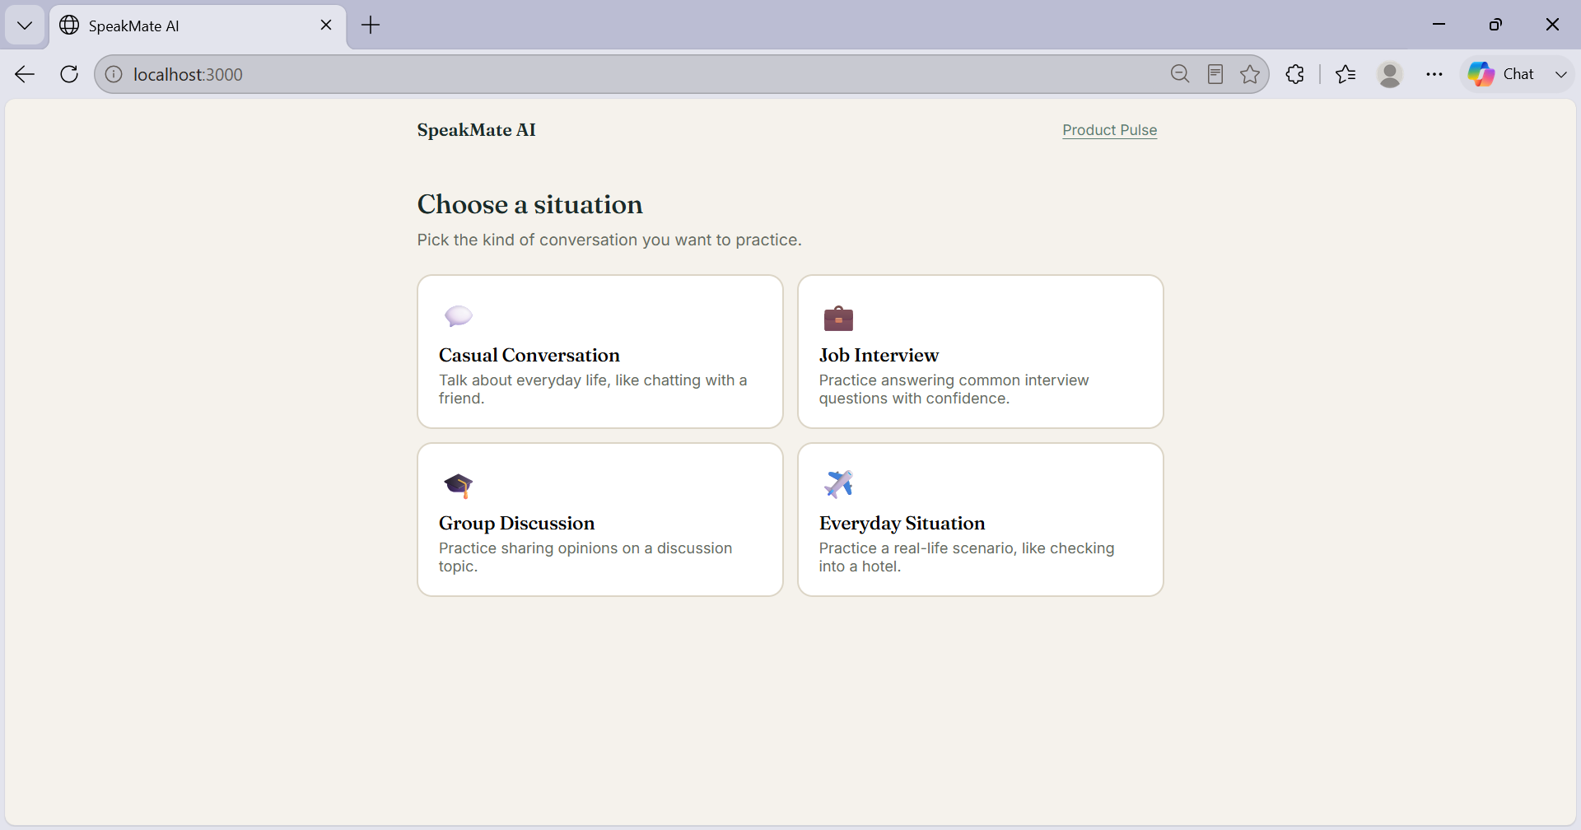
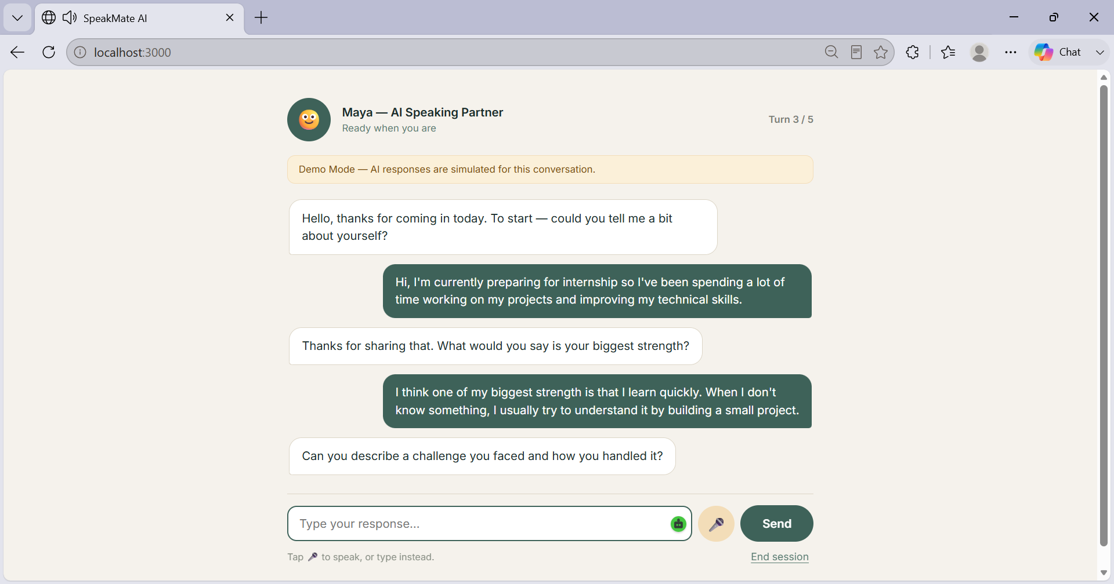
Meet Maya — Your AI Speaking Partner
Choose a scenario
→
Speak or type
→
Talk with Maya
→
Receive feedback
1
2
3
4
Choose a real-life situation
Voice + text conversation with Maya, 5 turns
MVP DESIGN DECISION
Keep sessions short enough to feel easy to start and finish.

Slide 4
Why Maya instead of a normal chatbot?
Traditional text chatbot
SpeakMate + Maya
– Primarily feels like messaging
✓ Voice + text interaction
– Less natural for speaking practice
✓ Scenario-based role-play
✓ Maya speaks back
– Less conversational presence
✓ Personalized feedback
MVP TRADE-OFFS
BUILT NOW
INTENTIONALLY DEFERRED
WHY?
✓ AI conversation
– Accounts / login
✓ 4 scenarios
– Payments
Focus the MVP on validating the core speaking-practice loop before investing in secondary features.
✓ Voice + text
– Social features
✓ AI avatar (Maya)
– Leaderboards
✓ Post-session feedback
– Pronunciation / accent analysis
✓ Product Pulse analytics
– Native mobile app

Slide 5
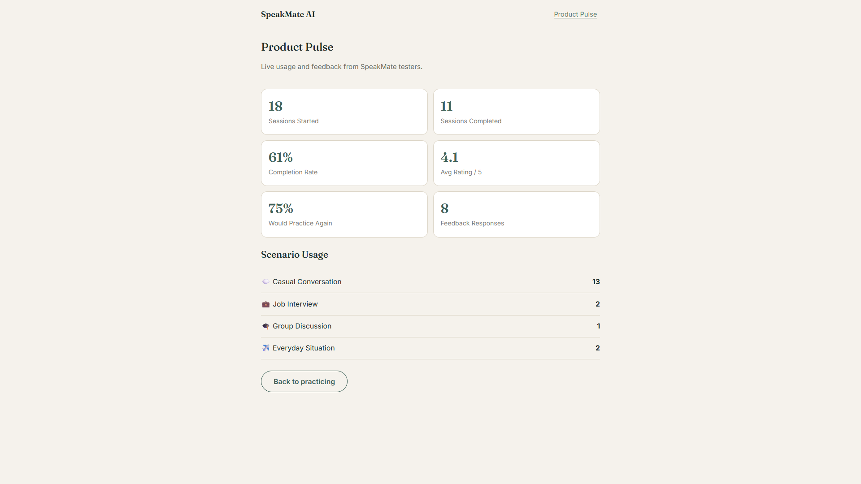
Early Validation
18
11
Sessions Started
Sessions Completed
61%
4.1 / 5
Completion Rate
Avg. Rating
75%*
8
Would Practice Again
Feedback Responses
Early testing data from SpeakMate Product Pulse.
*75% of feedback respondents said they would practice again.
Scenario usage — sessions started
Casual Conversation
13
Job Interview
2
Everyday Situation
2
Group Discussion
1

Slide 6
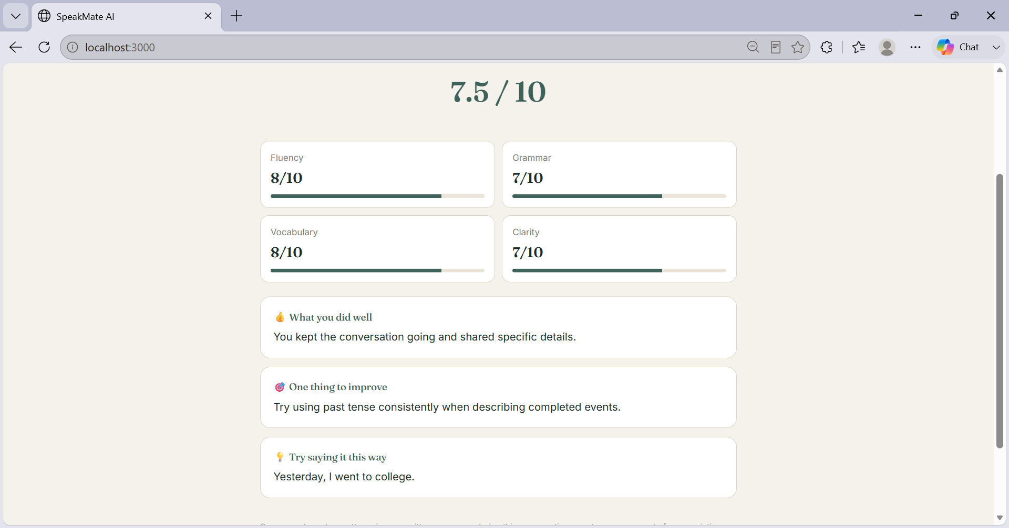
What I Learned From Testing
SHORT SESSIONS
MORE VARIETY
Feedback: Fewer questions made the experience easier to complete.
Feedback: Testers wanted additional scenarios.
Decision: Keep the core interaction short and low-friction.
Decision: Expand the scenario library based on demand.
Keep the low-friction core, then improve variety, feedback, and personalization.
BETTER FEEDBACK
PERSONALIZATION
Feedback: Users wanted more useful and specific feedback.
Feedback: Users suggested choosing the AI assistant's voice.
Decision: Improve the quality and personalization of post-session feedback.
Decision: Test voice personalization.

Slide 7
From MVP → Next Product Experiments
GO-TO-MARKET
WHAT I WOULD TEST NEXT
Beachhead
More scenarios: More relevant situations may increase usefulness.
Final-year college students and early-career job seekers preparing for interviews.
Better feedback: More specific feedback may increase repeat intent.
Initial channels
Voice choice: A personalized AI voice may improve engagement.
College placement groups · Student communities · LinkedIn · College communities
Repeat usage: Measure sessions per tester and return sessions.
“Practice your next interview before the real one.”
Scenario performance: Compare completion and repeat usage by scenario.
Feedback experiment: Test whether better feedback increases willingness to practice again.
Goal: Turn first-time practice into a repeatable speaking habit.

